Slide 1
Triangle In Triangle

Slide 2
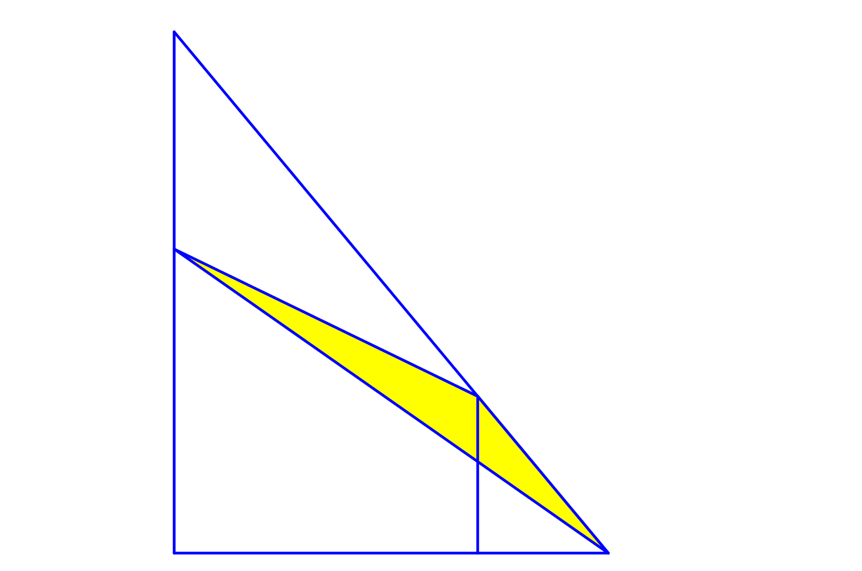


Triangle In Triangle
Find the area of the shaded triangle.
$$5$$
$$3$$
(not drawn to scale)

Slide 3



Triangle In Triangle
Let the largest triangle be $H$ units high and $W$ units wide.
Using area subtraction, the required area is given by:
$\frac{1}{2}×HW−\frac{1}{2}×5\left(W−3\right)−\frac{1}{2}×\left(H−5\right)W$
$\frac{1}{2}\left[HW−\left(5W−15\right)−\left(HW−5W\right)\right]$
$\frac{1}{2}\left[HW−5W+15−HW+5W\right]$
$\frac{15}{2}=7.5$ sq. units.
$$5$$
$$H−5$$
$$W−3$$
$$3$$

Slide 4
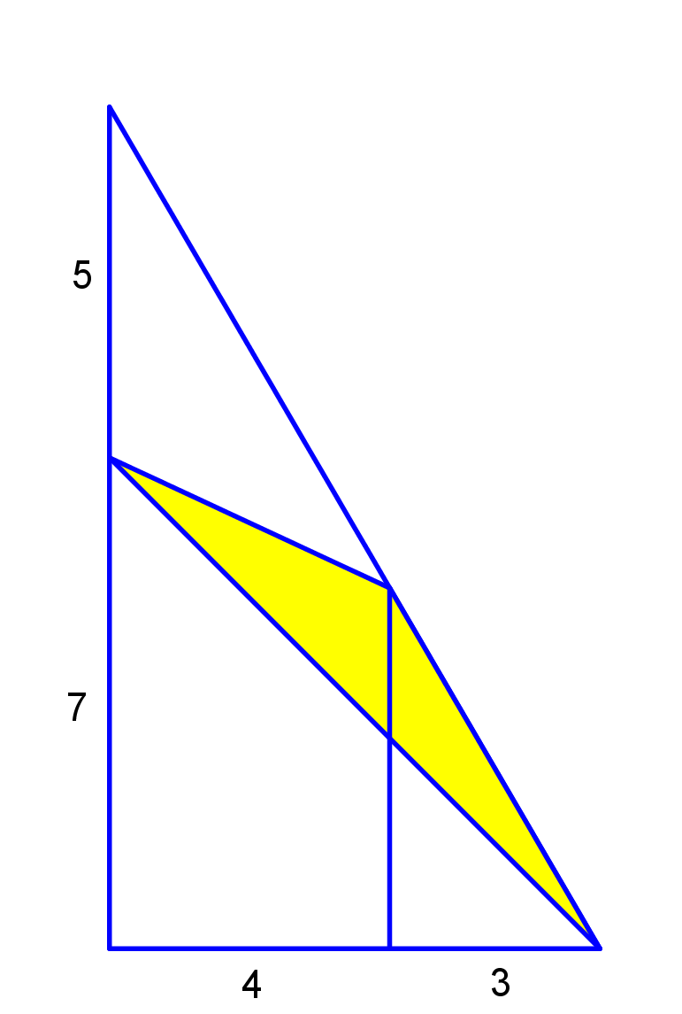
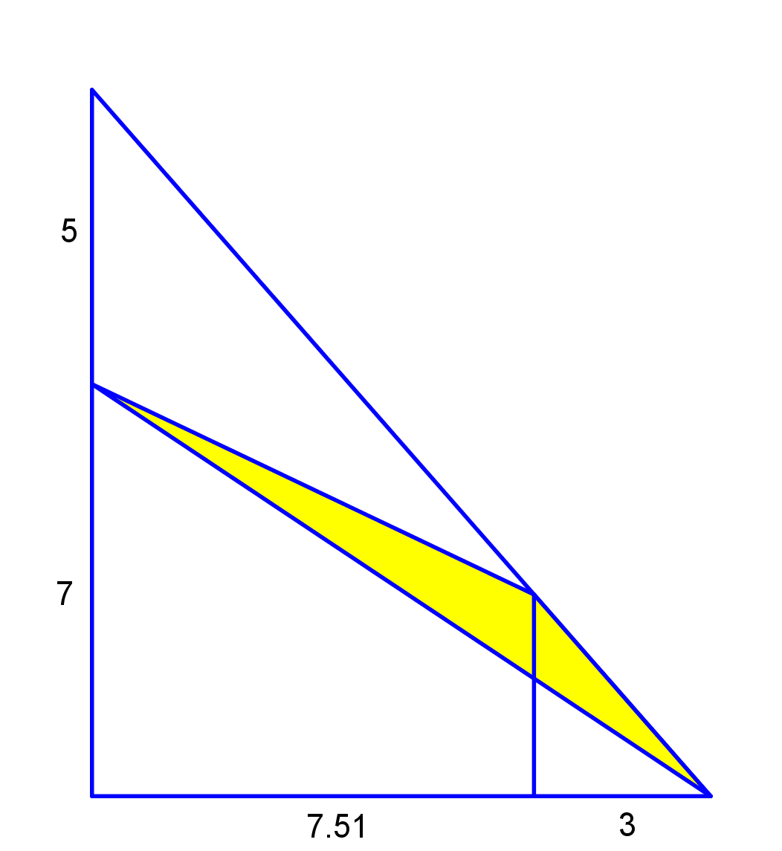
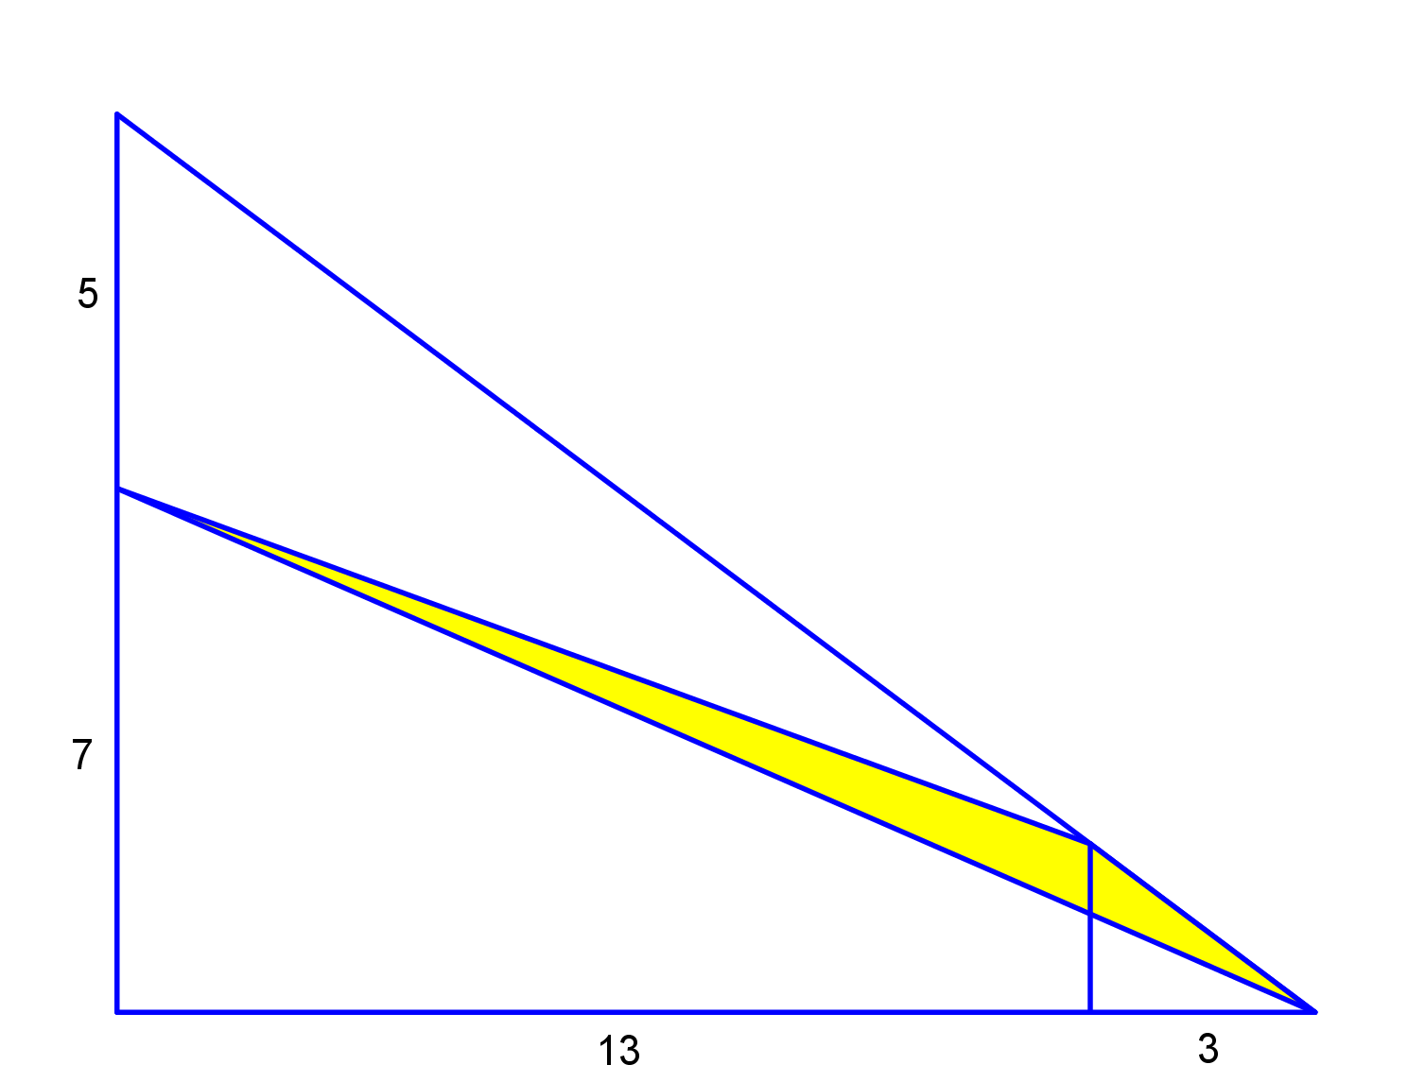
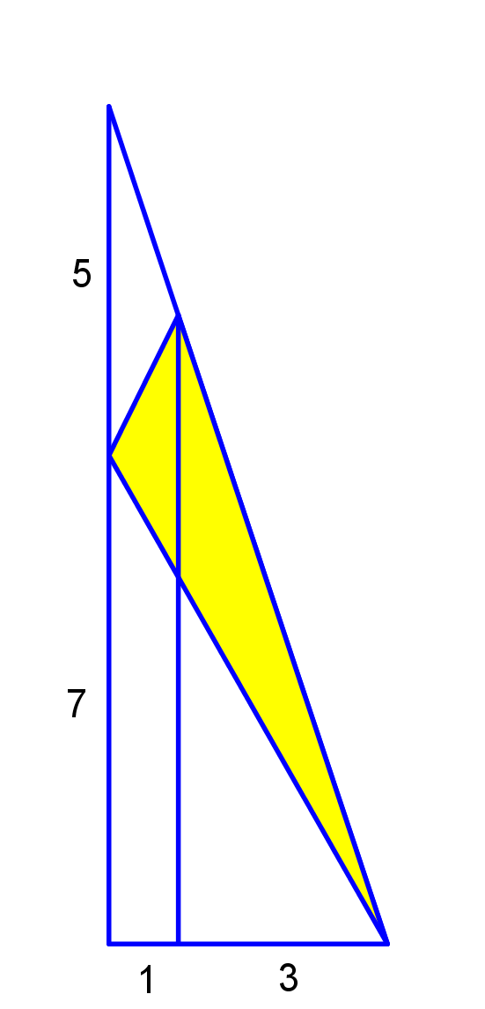
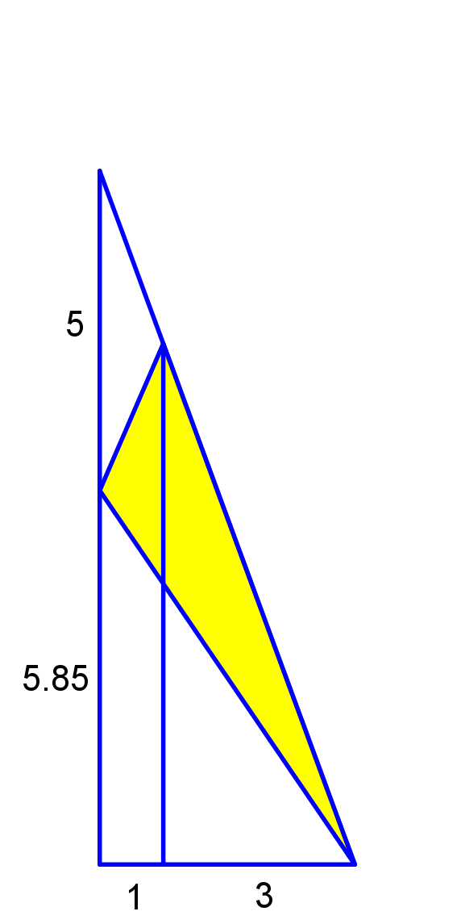
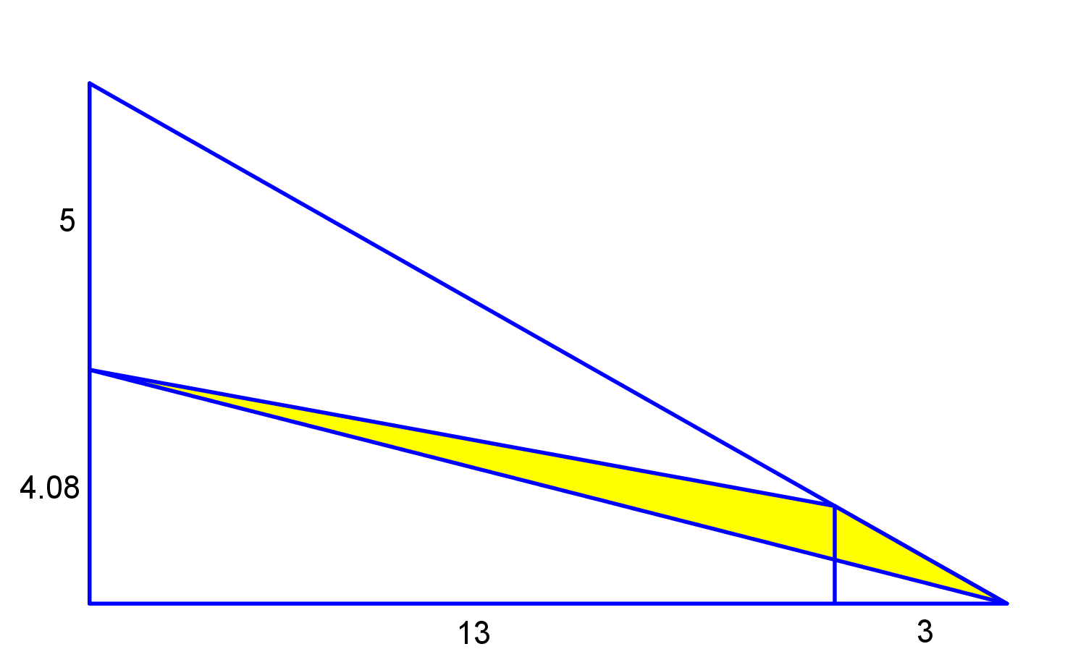
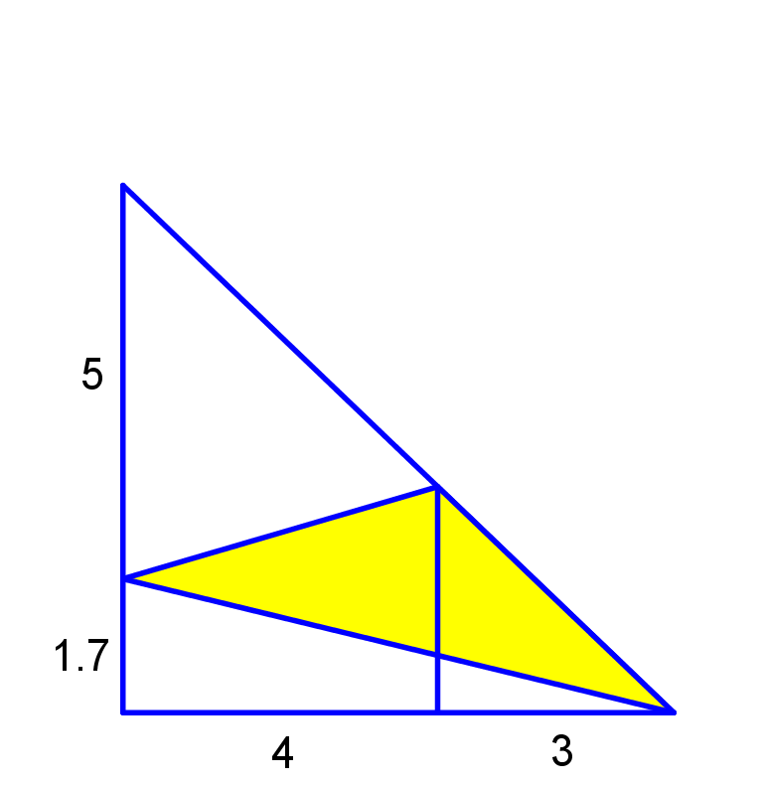
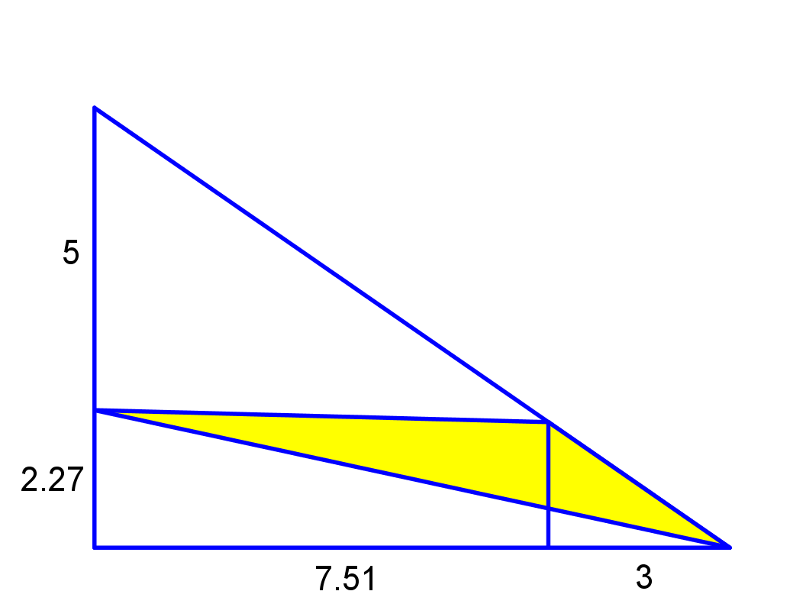

Triangle In Triangle
Note that since the values of $H$ and $W$didn’t appear in the answer, they must be irrelevant!
All of the shaded triangles have the same area!

Slide 5





Triangle In Triangle
Now let’s look at the general case and use letters for the numbers.
Using area subtraction, the required area is given by:
$\frac{1}{2}×HW−\frac{1}{2}×P\left(W−Q\right)−\frac{1}{2}×\left(H−P\right)W$
$\frac{1}{2}\left[HW−\left(PW−PQ\right)−\left(HW−PW\right)\right]$
$\frac{1}{2}\left[HW−PW+PQ−HW+PW\right]$
$\frac{PQ}{2}$ sq. units.
$$P$$
$$H−P$$
Now you can check your own answer.
$$W−Q$$
$$Q$$

Slide 7

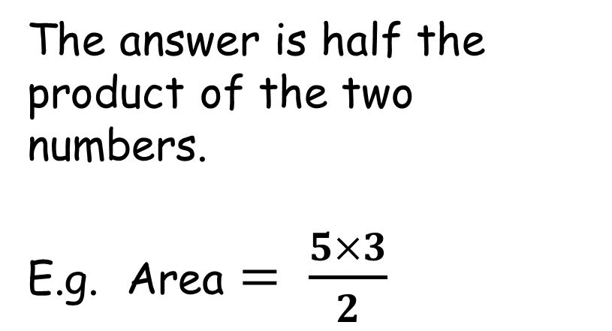

NOTE TO TEACHER - 1
The answer is half the product of the two numbers.
E.g. Area $= \frac{5×3}{2}$
$$5$$
$$3$$
(not drawn to scale)

Slide 8
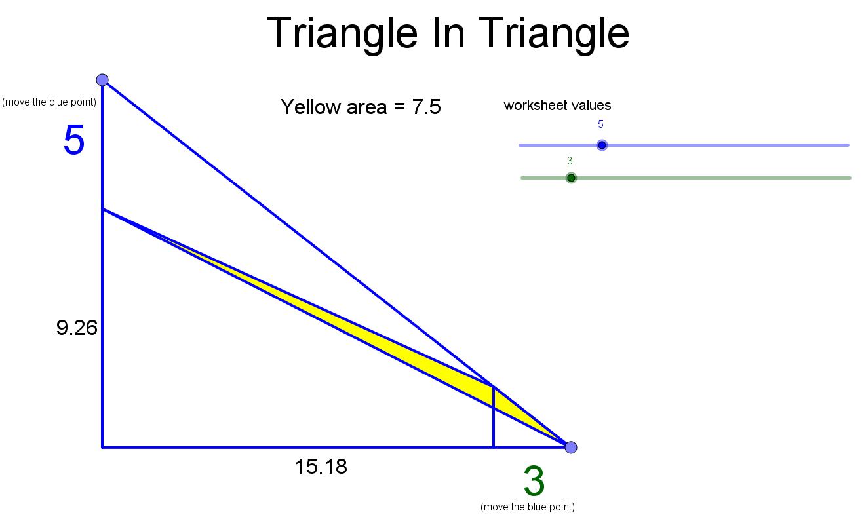
NOTE TO TEACHER - 2
Use the Geogebra applet to demonstrate changing the parameters and moving the vertices.

Slide 9
RESOURCES

Slide 10

Triangle In Triangle
SIC_93
Find the area of the shaded triangle.
$$5$$
$$2$$
(not drawn to scale)

Slide 11

Triangle In Triangle
SIC_93
Find the area of the shaded triangle.
$$6$$
$$2$$
(not drawn to scale)

Slide 12
Triangle In Triangle
SIC_93
Find the area of the shaded triangle.
$$6$$
$$3$$
(not drawn to scale)

Slide 13

Triangle In Triangle
SIC_93
Find the area of the shaded triangle.
$$7$$
$$3$$
(not drawn to scale)

Slide 14

Triangle In Triangle
SIC_93
Find the area of the shaded triangle.
$$7$$
$$4$$
(not drawn to scale)

Slide 15

Triangle In Triangle
SIC_93
Find the area of the shaded triangle.
$$8$$
$$4$$
(not drawn to scale)

Slide 16

Triangle In Triangle
SIC_93
Find the area of the shaded triangle.
$$8$$
$$5$$
(not drawn to scale)

Slide 17

Triangle In Triangle
SIC_93
Find the area of the shaded triangle.
$$9$$
$$5$$
(not drawn to scale)

Slide 18

Triangle In Triangle
SIC_93
Find the area of the shaded triangle.
$$9$$
$$6$$
(not drawn to scale)

Slide 19

Triangle In Triangle
SIC_93
Find the area of the shaded triangle.
$$10$$
$$6$$
(not drawn to scale)

Slide 20
Triangle In Triangle
SIC_93
Find the area of the shaded triangle.
$$10$$
$$5$$
(not drawn to scale)

Slide 21

Triangle In Triangle
SIC_93
Find the area of the shaded triangle.
$$12$$
$$5$$
(not drawn to scale)

Slide 22
Triangle In Triangle
SIC_93
Find the area of the shaded triangle.
$$12$$
$$6$$
(not drawn to scale)

Slide 23

Triangle In Triangle
SIC_93
Find the area of the shaded triangle.
$$14$$
$$6$$
(not drawn to scale)

Slide 24

Triangle In Triangle
SIC_93
Find the area of the shaded triangle.
$$14$$
$$7$$
(not drawn to scale)

Slide 25


Triangle In Triangle
SIC_93
Find the area of the shaded triangle.
$$15$$
$$8$$
(not drawn to scale)

Slide 26

Triangle In Triangle
SIC_93
Find the area of the shaded triangle.
$$16$$
$$8$$
(not drawn to scale)

Slide 27

Triangle In Triangle
SIC_93
Find the area of the shaded triangle.
$$16$$
$$9$$
(not drawn to scale)

Slide 28
Triangle In Triangle
SIC_93
Find the area of the shaded triangle.
$$16$$
$$7$$
(not drawn to scale)

Slide 29
Triangle In Triangle
SIC_93
Find the area of the shaded triangle.
$$16$$
$$6$$
(not drawn to scale)

Slide 30
Triangle In Triangle
SIC_93
Find the area of the shaded triangle.
$$16$$
$$5$$
(not drawn to scale)

Slide 31

Triangle In Triangle
SIC_93
Find the area of the shaded triangle.
$$18$$
$$5$$
(not drawn to scale)

Slide 32
Triangle In Triangle
SIC_93
Find the area of the shaded triangle.
$$18$$
$$4$$
(not drawn to scale)

Slide 33
Triangle In Triangle
SIC_93
Find the area of the shaded triangle.
$$18$$
$$9$$
(not drawn to scale)

